Slide 1
CSE 2217/CSI 227: Data Structure and Algorithms-II

Slide 2
Analysis
Worst case
Provides an upper bound on running time
An absolute guarantee
Average case
Provides the expected running time
Very useful, but treat with care: what is “average”?
Random (equally likely) inputs
Real-life inputs

Slide 3
An Example: Insertion Sort
InsertionSort(A) {
for j <- 2 to Length[A] {
key <- A[j]
//insert A[j] into a sorted sequence A[1…j-1]
i <- j - 1;
while (i > 0) and (A[i] > key) {
A[i+1] <- A[i]
i <- i - 1
}
A[i+1] <- key
}
}

Slide 4
An Example: Insertion Sort (Cont..)
Problem: Sort the sequence {3, 7, 4, 9, 5, 2, 6, 1}
3 7 4 9 5 2 6 1
3 7 4 9 5 2 6 1
3 7 4 9 5 2 6 1
3 4 7 9 5 2 6 1
3 4 7 9 5 2 6 1
3 4 5 7 9 2 6 1
2 3 4 5 7 9 6 1
2 3 4 5 6 7 9 1
1 2 3 4 5 6 7 9
InsertionSort(A) {
for j <- 2 to Length[A] {
key <- A[j]
//insert A[j] into a sorted A[1…j-1]
i <- j - 1;
while (i > 0) and (A[i] > key) {
A[i+1] <- A[i]
i <- i - 1
}
A[i+1] <- key
}
}

Slide 5
Insertion Sort
InsertionSort(A) {
for j <- 2 to Length[A] {
key <- A[j]
//insert A[j] into a sorted sequence A[1…j-1]
i <- j - 1;
while (i > 0) and (A[i] > key) {
A[i+1] <- A[i]
i <- i - 1
}
A[i+1] <- key
}
}
How many times will this loop execute?

Slide 6
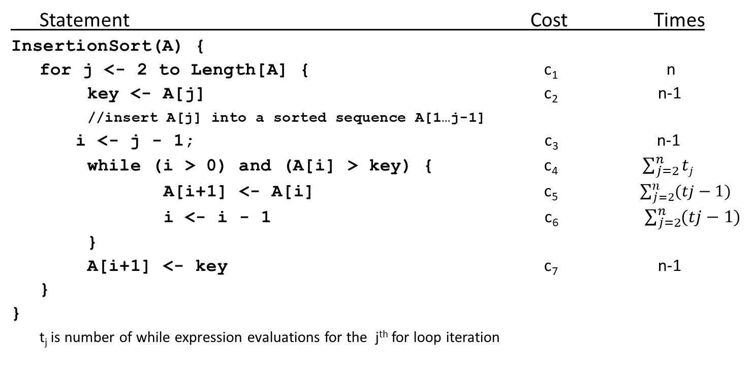
Insertion Sort
Statement Cost Times
InsertionSort(A) {
for j <- 2 to Length[A] { c₁ n
key <- A[j] c₂ n-1
//insert A[j] into a sorted sequence A[1…j-1]
i <- j - 1; c₃ n-1
while (i > 0) and (A[i] > key) { c₄ $\sum_{j=2}^{n}{tj}$
A[i+1] <- A[i] c₅ $\sum_{j=2}^{n}{(tj}−1)$
i <- i - 1 c₆ $\sum_{j=2}^{n}{(tj}−1)$
}
A[i+1] <- key c₇ n-1
}
}
t_{j} is number of while expression evaluations for the j^{th} for loop iteration

Slide 7
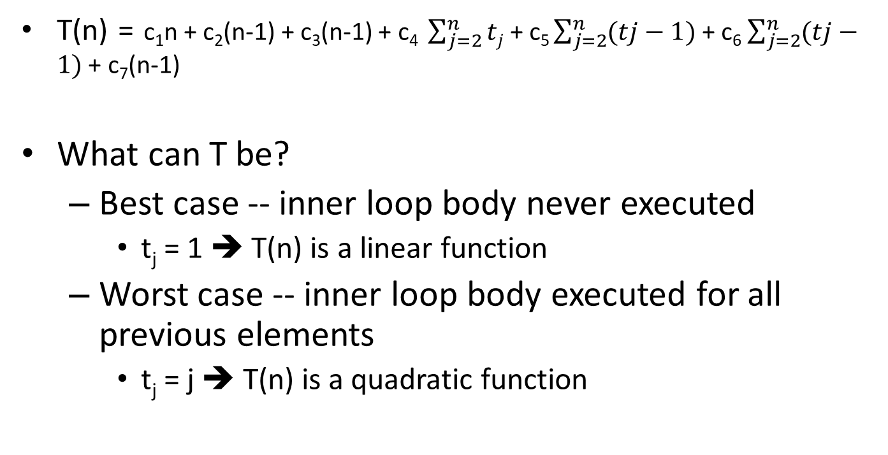
Analyzing Insertion Sort
T(n) = c₁n + c₂(n-1) + c₃(n-1) + c₄ $\sum_{j=2}^{n}{tj}$ + c₅ $\sum_{j=2}^{n}{(tj}−1)$ + c₆ $\sum_{j=2}^{n}{(tj}−1)$ + c₇(n-1)
What can T be?
Best case -- inner loop body never executed
t_{j} = 1 ➔ T(n) is a linear function
Worst case -- inner loop body executed for all previous elements
t_{j} = j ➔ T(n) is a quadratic function

Slide 8
Divide and Conquer (Merge Sort)

Slide 9
Divide and Conquer
Recursive in structure
Divide the problem into sub-problems that are similar to the original but smaller in size
Conquer the sub-problems by solving them recursively. If they are small enough, just solve them in a straightforward manner.
Combine the solutions to create a solution to the original problem

Slide 10
Divide-and-Conquer Technique (cont.)
a problem of size n
(instance)
subproblem 1
of size n/2
subproblem 2
of size n/2
a solution to
subproblem 1
a solution to
subproblem 2
a solution to
the original problem
It general leads to a recursive algorithm!

Slide 11
Divide-and-Conquer Examples
Sorting: mergesort and quicksort
Binary tree traversals
Multiplication of large integers
Matrix multiplication: Strassen’s algorithm
Closest-pair and convex-hull algorithms

Slide 12
An Example: Merge Sort
Sorting Problem: Sort a sequence of n elements into non-decreasing order.
Divide: Divide the n-element sequence to be sorted into two subsequences of n/2 elements each
Conquer: Sort the two subsequences recursively using merge sort.
Combine: Merge the two sorted subsequences to produce the sorted answer.

Slide 13
Merge-Sort (A, p, r)
INPUT: a sequence of n numbers stored in array A
OUTPUT: an ordered sequence of n numbers
MergeSort (A, p, r) // sort A[p..r] by divide & conquer
if p < r
then q ← ⎣(p+r)/2⎦
MergeSort (A, p, q)
MergeSort (A, q+1, r)
Merge (A, p, q, r) // merges A[p..q] with A[q+1..r]
Initial Call: MergeSort(A, 1, n)

Slide 14
Procedure Merge
Merge(A, p, q, r)
1 n₁ ← q – p + 1
2 n₂ ← r – q
for i ← 1 to n₁
do L[i] ← A[p + i – 1]
for j ← 1 to n₂
do R[j] ← A[q + j]
L[n₁+1] ← ∞
R[n₂+1] ← ∞
i ← 1
j ← 1
for k ←p to r
do if L[i] ≤ R[j]
then A[k] ← L[i]
i ← i + 1
else A[k] ← R[j]
j ← j + 1
Input: Array containing sorted subarrays A[p..q] and A[q+1..r].
Output: Merged sorted subarray in A[p..r].
Sentinels, to avoid having to
check if either subarray is
fully copied at each step.

Slide 15
Merge – Example
A
…
6
8
26
32
1
9
42
43
…
1
6
8
9
26
32
42
43
k
k
k
k
k
k
k
k
k
L
6
8
26
32
∞
R
6
8
26
32
1
9
42
43
∞
1
9
42
43
i
i
i
i
i
j
j
j
j
j

Slide 16
Analysis of Merge Sort
Running time T(n) of Merge Sort:
Divide: computing the middle takes Θ(1)
Conquer: solving 2 subproblems takes 2T(n/2)
Combine: merging n elements takes Θ(n)
Total:
T(n) = Θ(1) if n = 1
T(n) = 2T(n/2) + Θ(n) if n > 1
⇒ T(n) = Θ(n lg n) (CLRS, Chapter 4)

